Slide 1
Subject Name : EC8491- Communication Theory Presentation Title : Real Time Applications Of FDM
JEPPIAAR INSTITUTE OF TECHNOLOGY
“Self-Belief | Self Discipline | Self Respect”
Department of Electronics and Communication Engineering
Team Members:
Students Name Reg.No:
1. GOPALA KRISHNAN S 210618106014
2. STANISH ROSHAN P 210618106037
3. ROHITH LEMATER M 210618106032
4. NIVETHA 210618106301
5. KEERTHANA S 210618106020
6. LAVANYA M 210618106021

Slide 2
OBJECTIVES
To know about the basic concept of multiplexing.
To know about its types , working & its uses.
To know about the real time applications of FDM.

Slide 3
WHAT IS MULTIPLEXING?
It is a way of transmitting various signals over a media or single line. A common kind of multiplexing merges a number of low-speed signals to send over an only high-speed link, or it is used to transmit a medium as well as its link with the number of devices.
It provides both privacy & Efficiency.
The entire process can be done using a device namely MUX or multiplexer.

Slide 4
TYPES OF FDM
Frequency Division Multiplexing (FDM)
Wavelength Division Multiplexing (WDM)
Time Division Multiplexing (TDM)

Slide 5
WHAT IS FREQUENCY DIVISION MULTIPLEXING ?
Frequency Division Multiplexing (FDM) is a networking technique in which multiple data signals are combined for simultaneous transmission via a shared communication medium.
FDM uses a carrier signal at a discrete frequency for each data stream and then combines many modulated signals

Slide 6
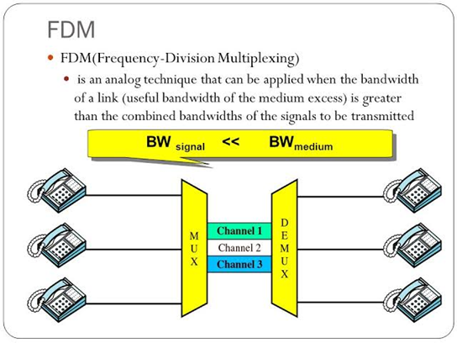
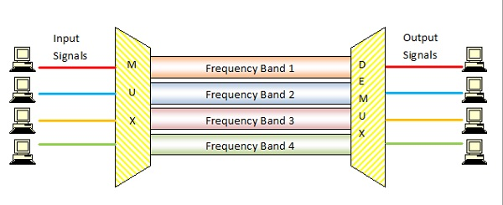
Block Diagram

Slide 7
Modulation of signal
The signals which are to be multiplexed will each modulate a separate carrier .The type of modulation can be AM, SSB, FM or PM .
The modulated signals are then added together to form a complex signal which is transmitted over a single channel.

Slide 8
Technical Details
Each signal modulates a separate carrier . The modulator outputs will contain the sidebands of the corresponding signals .
The modulator outputs are added together in a linear mixer or adder.
The linear mixer is different from the normal mixers. Here the sum and difference frequency components are not produced . But only the algebraic addition of the modulated outputs will take place .
Different signals are thus added together i the time domain but they have a separate identity in the frequency domain .
The composite signal at the output of mixer is transmitted over the single communication channel as shown in fig.2 . This signal can be used to modulate a radio transmitter if the FDM signal is to be transmitted through air .

Slide 9
FDM TRANSMITTERS
Each signal that needs to be sent over a communication channel undergoes modulation with various carrier frequencies, as shown clearly in the diagram below.
There are different kinds of modulation such as amplitude modulation, pulse modulation, frequency modulation etc. As the name suggests, the modulation done here is frequency modulation by the FDM transmitter.
These modulated signals are then added up using a linear adder or a mixer, forming a composite signal which gets transmitted over a communication channel (single channel).

Slide 10
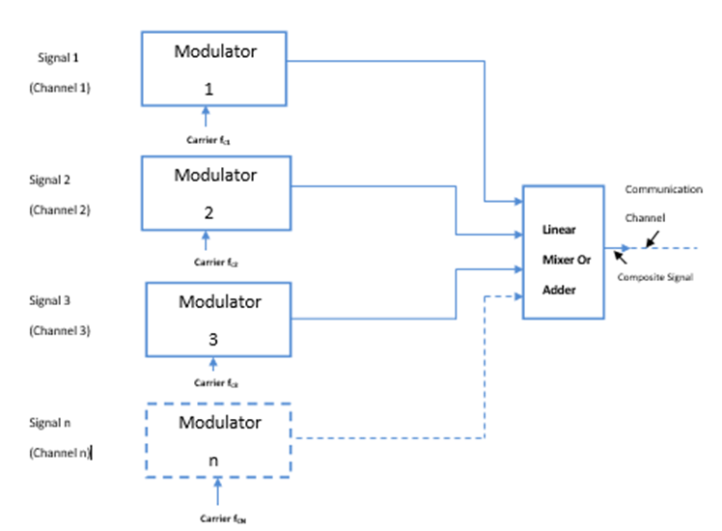
FDM TRANSMITTER BLOCK DIAGRAM

Slide 11
FDM RECEIVERS
At the receiving end, the single composite signal is received by the FDM receiver.
The receiver then passes the composite signal through various band pass filters.
Each of these band pass filters has a frequency corresponding to the frequencies of one of the carrier waves. Each band pass filter will accept the signal whose frequency matches with the frequency of the carrier signal and rejects all other channels.
The signals coming out of band pass filters pass through a demodulator. The demodulator does the work of separating the original signal from the carrier signal.

Slide 12
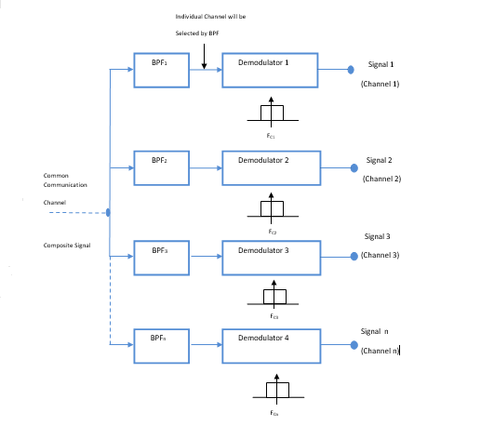
BLOCK DIAGRAM FOR FDM RECEIVERS

Slide 13
FDM -Advantages
It does not need synchronization between its transmitter and receiver.
It is simpler and easy demodulation.
Due to slow narrow band fading only one channel gets affected.
It is used for analog signals.
A large number of signals (channels) can be transmitted simultaneously.

Slide 14
FDM -Disadvantages
It is suffers problem of cross-talk.
It is used only when a few low speed channels are desired.
Intermodulation distortion takes place.

Slide 15
Future Scope
Maybe, capacity and performance could be improved by incorporating channel estimation in the multi user receiver to estimate the phase and amplitude changes due to the flat fading channel characteristics.
The performance of the system in the frequency selective channel could be improved by employing adaptive equalizers in the multi user receiver.

Slide 16
Reference
https://en.wikipedia.org/wiki/Frequency-division_multiplexing
https://www.elprocus.com/what-is-multiplexing-types-and-their-applications/
https://www.tutorialspoint.com/frequency-division-multiplexing

